Slide 1


DSA Bootcamp

Slide 2
Complexity

Slide 3
Data structure and algorithm
Q1. Indicate constant time complexity in terms of Big-O notation
O(n)
O(1)
O(n²)
O(logn)
Q2. If an algorithm runs in quadratic time, what is its time complexity using Big-O ?
O(N²)
O(N)
O(1)
O(log N)
Q3. The time complexity of binary search is given by
Constant
Quadratic
Exponential
Logarithmic

Slide 4
Q4. What is the time complexity of the following code:
int a = 0;
for (i = 0; i < N; i++) {
for (j = N; j > i; j--) {
a = a + i + j;
}
}
O(N)
O(N*log(N))
O(N * Sqrt(N))
O(N*N)
Q5. How is time complexity measured?
By counting the number of algorithms in an algorithm.
By counting the number of primitive operations performed by the algorithm on given input size.
By counting the size of data input to the algorithm.
None of the above

Slide 5
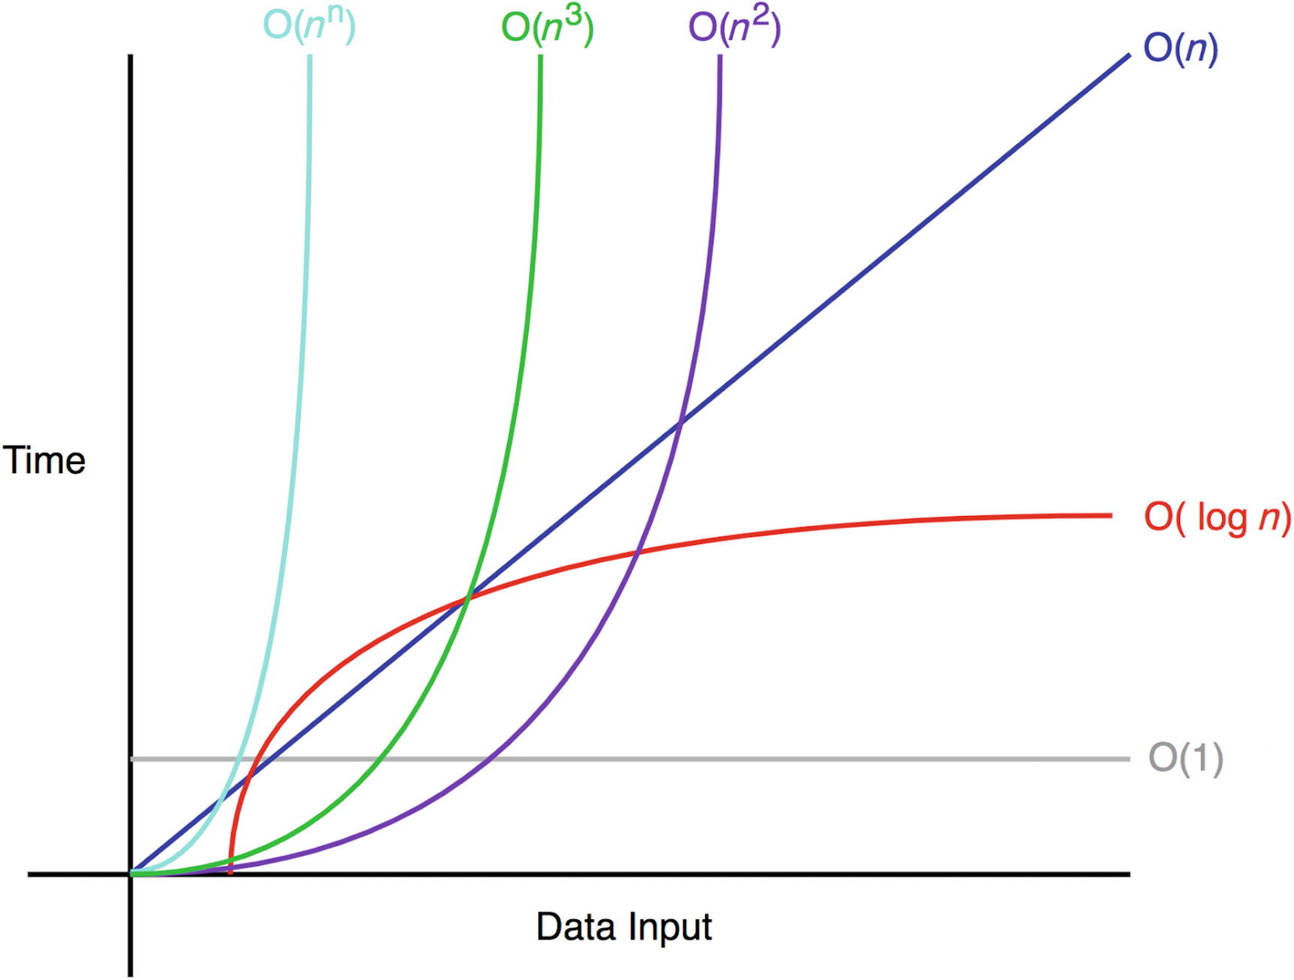

Slide 6
Problems

Slide 7
Q1 :Find the missing element in the given Array containing distinct element from 0 to n ?
Arr =[1,2,3,5]
output: 4

Slide 8
Q2. Given an array , remove the duplicates elements of the array.
Sample input : [0,1,2,3,3,4,5,6,6,9]
Output :[0,1,2,3,4,5,6,9]

Slide 9
Q3.Find the frequency of elements in an Array?
Sample input =[1,3,3,4,2,3,6,6,1,0,9]
Output=> 1= 2times;
3= 3times;
4= 1 times;
2= 1times;
6 = 2times;
0= 1times;
9= 1times;

Slide 10
Q4.Given an integer array, sort its element by their frequency and index. i.e., if two elements have different frequencies, then the one which has more frequency should come first; otherwise, the one which has less index should come first.
Input : [3, 3, 1, 1, 1, 8, 3, 6, 8, 7, 8]
Output: [3, 3, 3, 1, 1, 1, 8, 8, 8, 6, 7]

Slide 11
Q6.Given an unsorted integer array, find a pair with the given sum in it.
Input:
nums = [8, 7, 2, 5, 3, 1]
target = 10
Output:
Pair found (8, 2)
or
Pair found (7, 3)
Input:
nums = [5, 2, 6, 8, 1, 9]
target = 12
Output: Pair not found

Slide 12
Thank You!
Copyright © HeroX Private Limited, 2022. All rights reserved.

